Slide 1
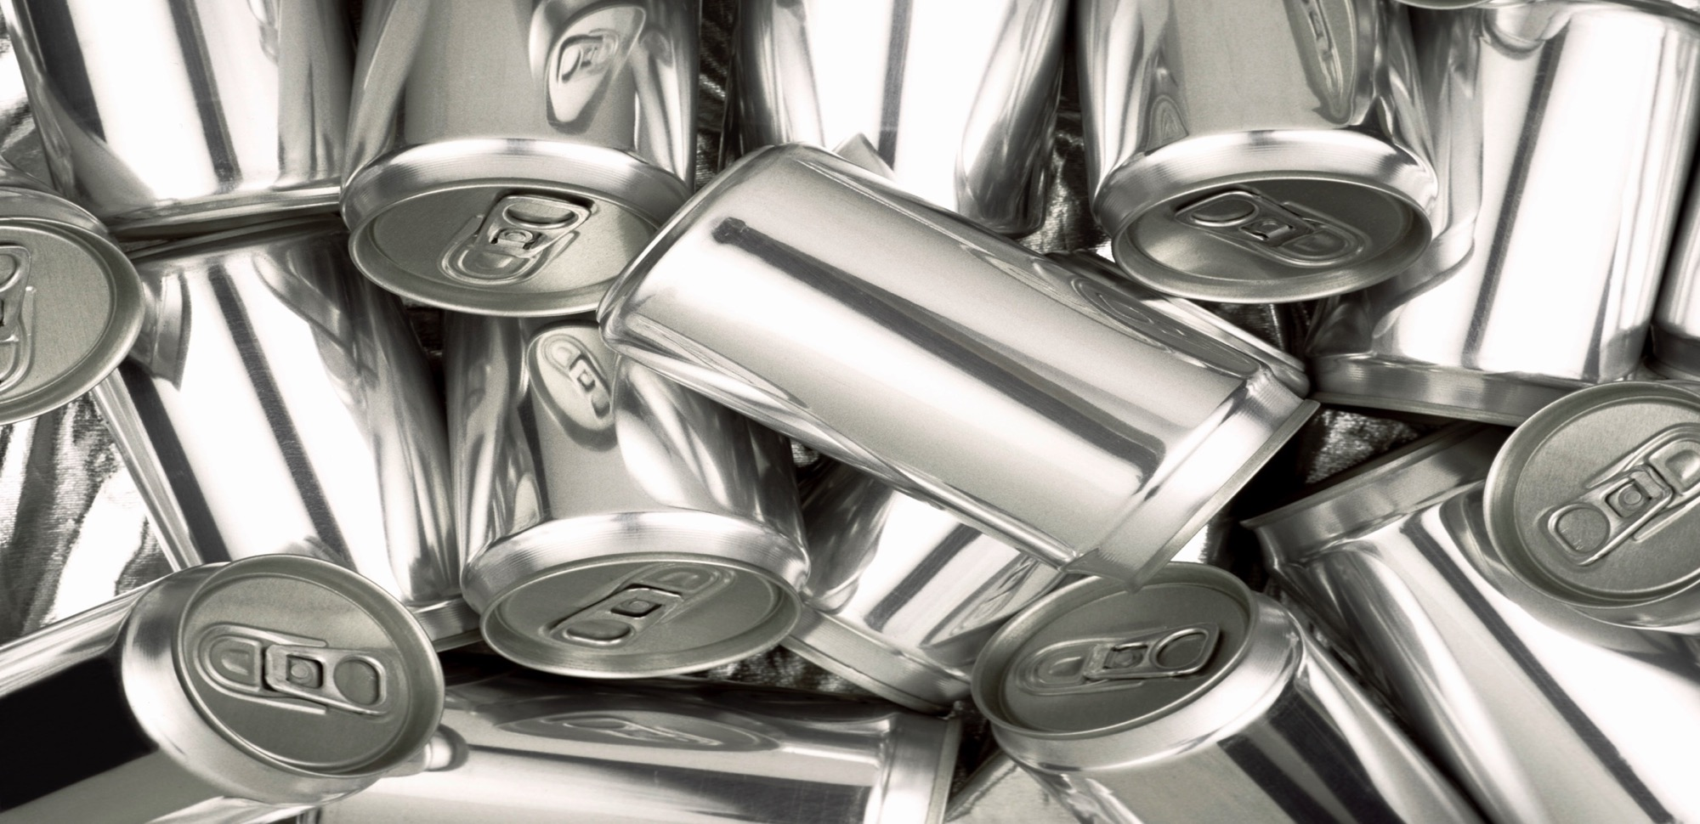

Saving Energy with
Recycling: I CAN!
© 2016 All rights reserved.

Slide 2
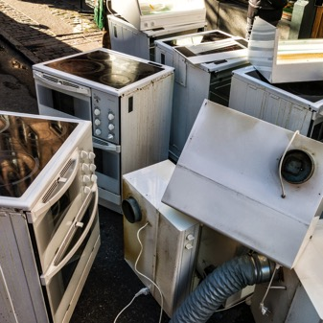

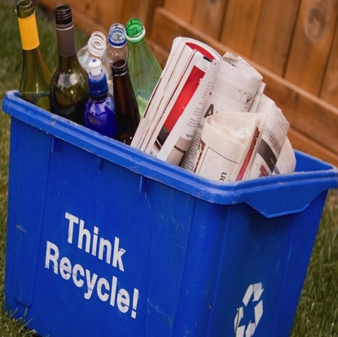

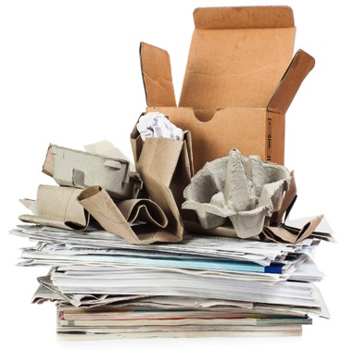
What do these items have in common?
Engage

Slide 3
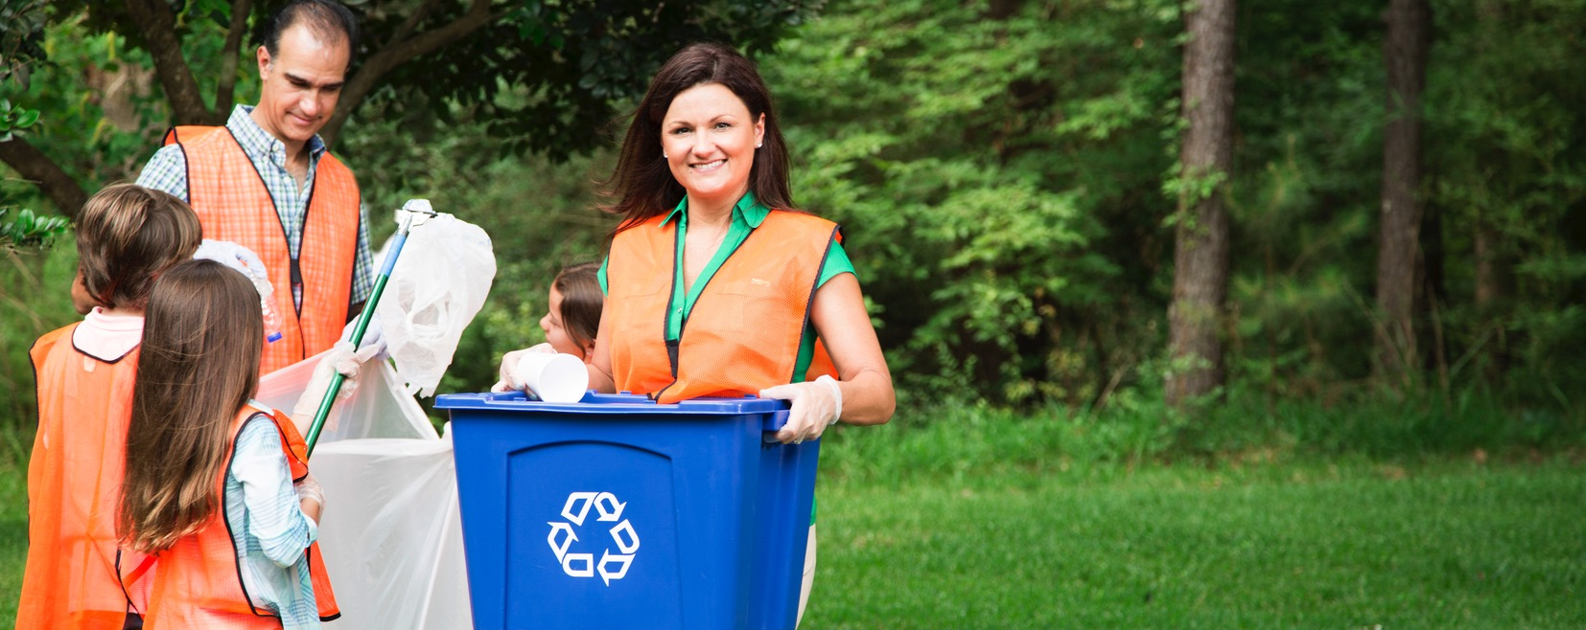





What does it mean to recycle?
What materials can be recycled?
Engage

Slide 4
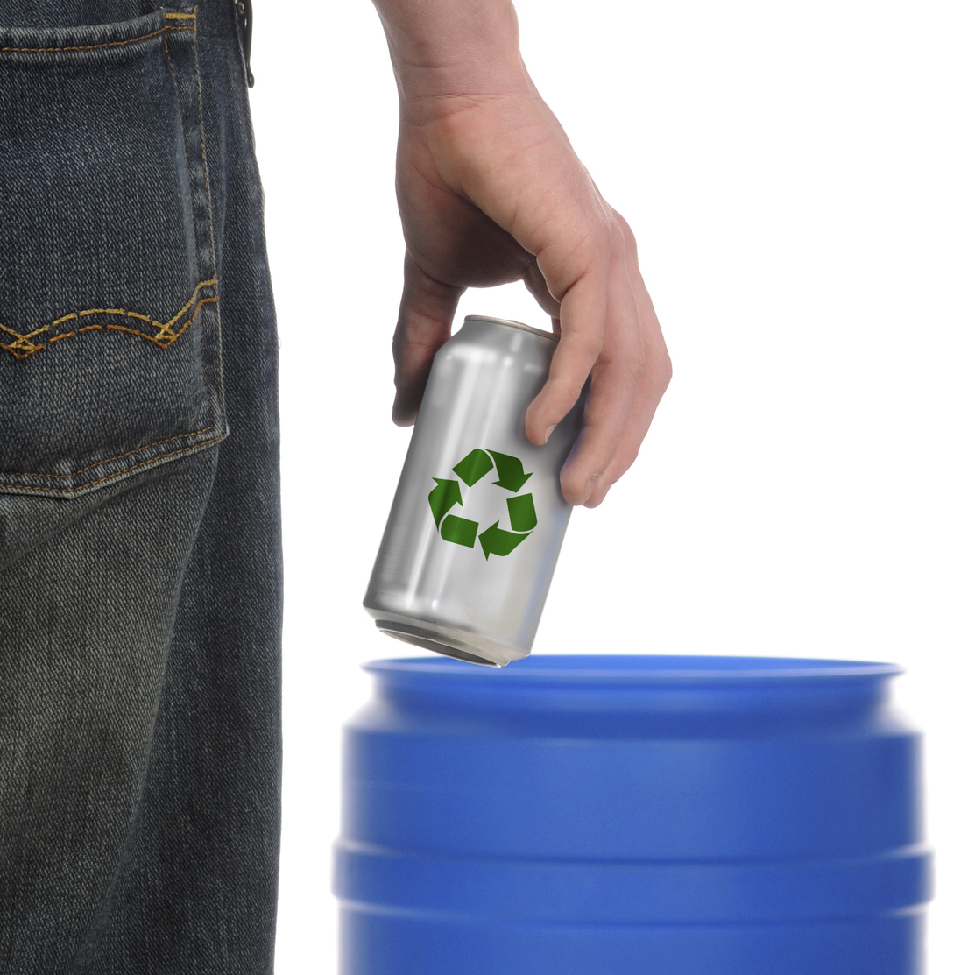
What do you do with your beverage cans?
Beverage cans are commonly recycled.
What element is used to
make this beverage can?
Aluminum
Engage

Slide 5
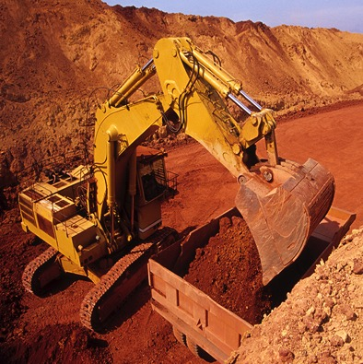

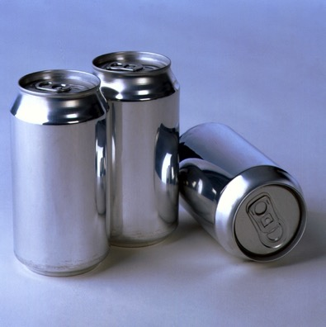
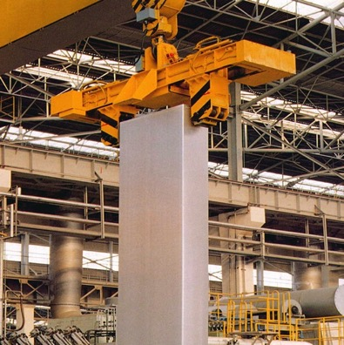
True or False?
Aluminum is very rare.
False!
Aluminum is the third most common element in the Earth’s crust, but it does not exist on its own. It must be extracted from bauxite ore.
Engage

Slide 6
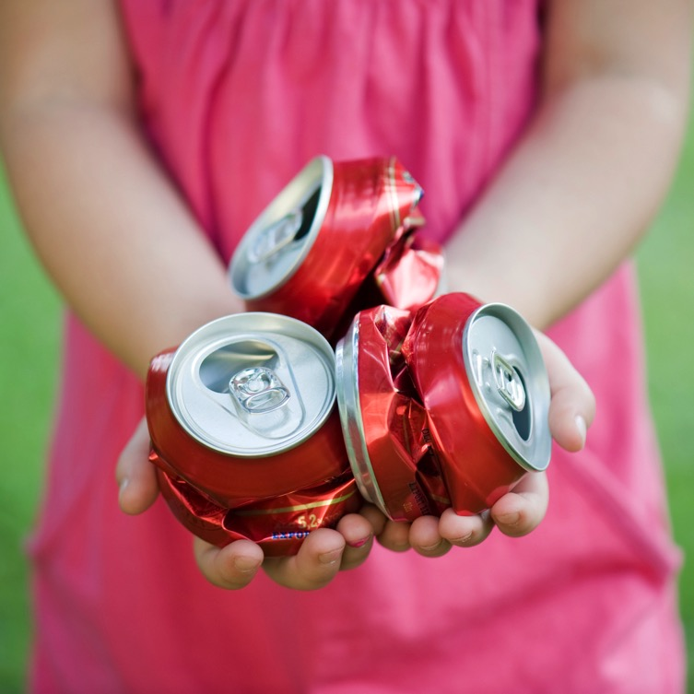
How old are aluminum cans?
Aluminum or Gold?
When aluminum was first discovered in 1825, it was more expensive than gold and silver!
Today, modern advances in aluminum production have enabled aluminum to be much more cost-efficient.
Engage
Notes:
DESIGN NOTES: Image of gold and aluminum

Slide 7
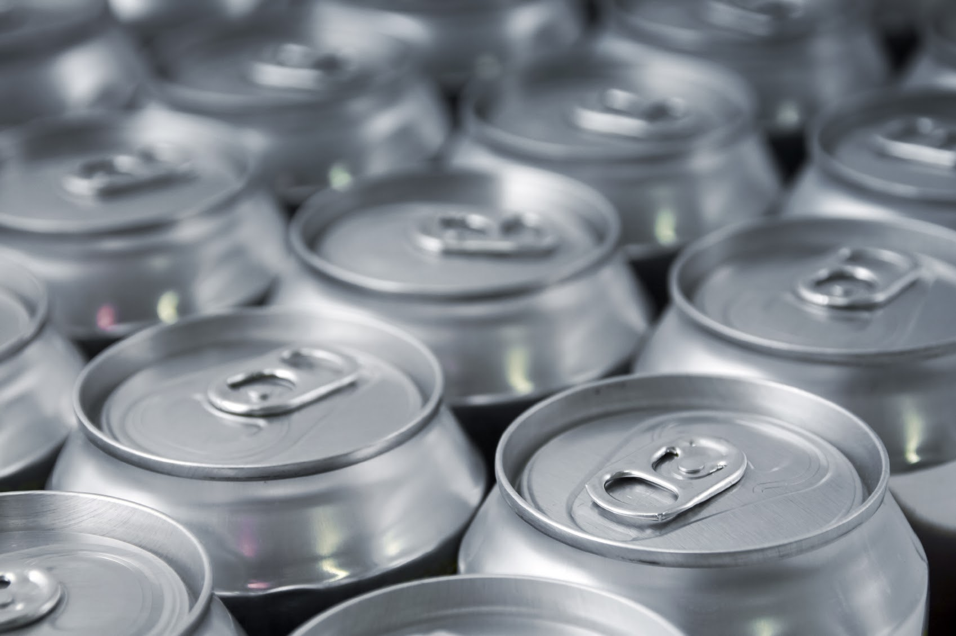
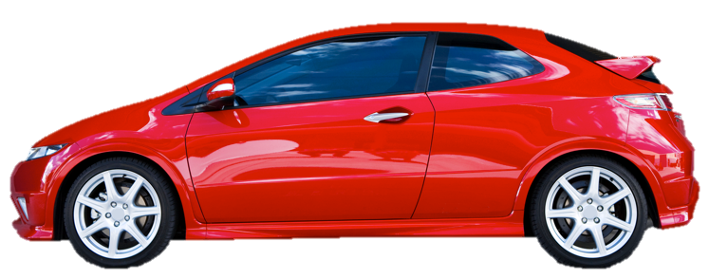
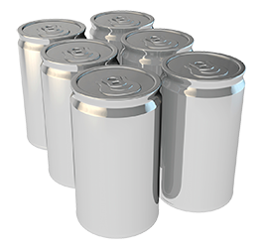
The strength of aluminum
How much weight can four six-packs of cans support?
Aluminum cans are VERY strong. Four six-packs of cans can support the weight of a 4,000 pound car. This is incredible considering the side of each can is only as thick as a human hair.
Engage

Slide 8


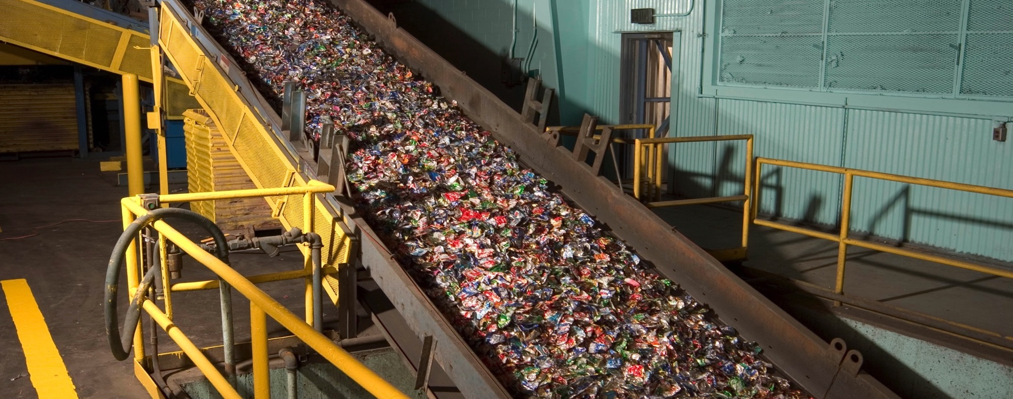
Around the Earth
About 100 billion aluminum cans are made in the U.S. each year. What happens to most of them?
Americans throw away approximately 100 million cans (100,000,000) each year! If you laid this many cans end-to-end, the line would...
  wrap around 1/3 of Earth’s circumference
  go back and forth across the U.S. one and a half times, with cans to spare
  reach the center of Earth and back
Engage

Slide 9

What Happens When We Don’t Recycle?
Explore

Slide 10

Why is it important to recycle aluminum cans?
Recycling:
Reduces waste in landfills
Conserves natural resources
Reduces energy use
How does recycling cans achieve these goals?
Explore

Slide 11
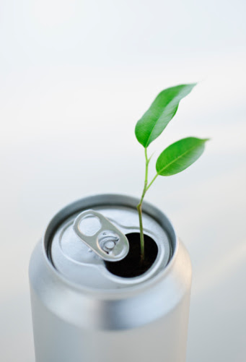
Life cycle of a can
The manufacturing process describes how aluminum cans are made.
Try to put the steps of the manufacturing process in the correct order, from the time that the aluminum comes out of the ground, until you drink the beverage.
Explain

Slide 12

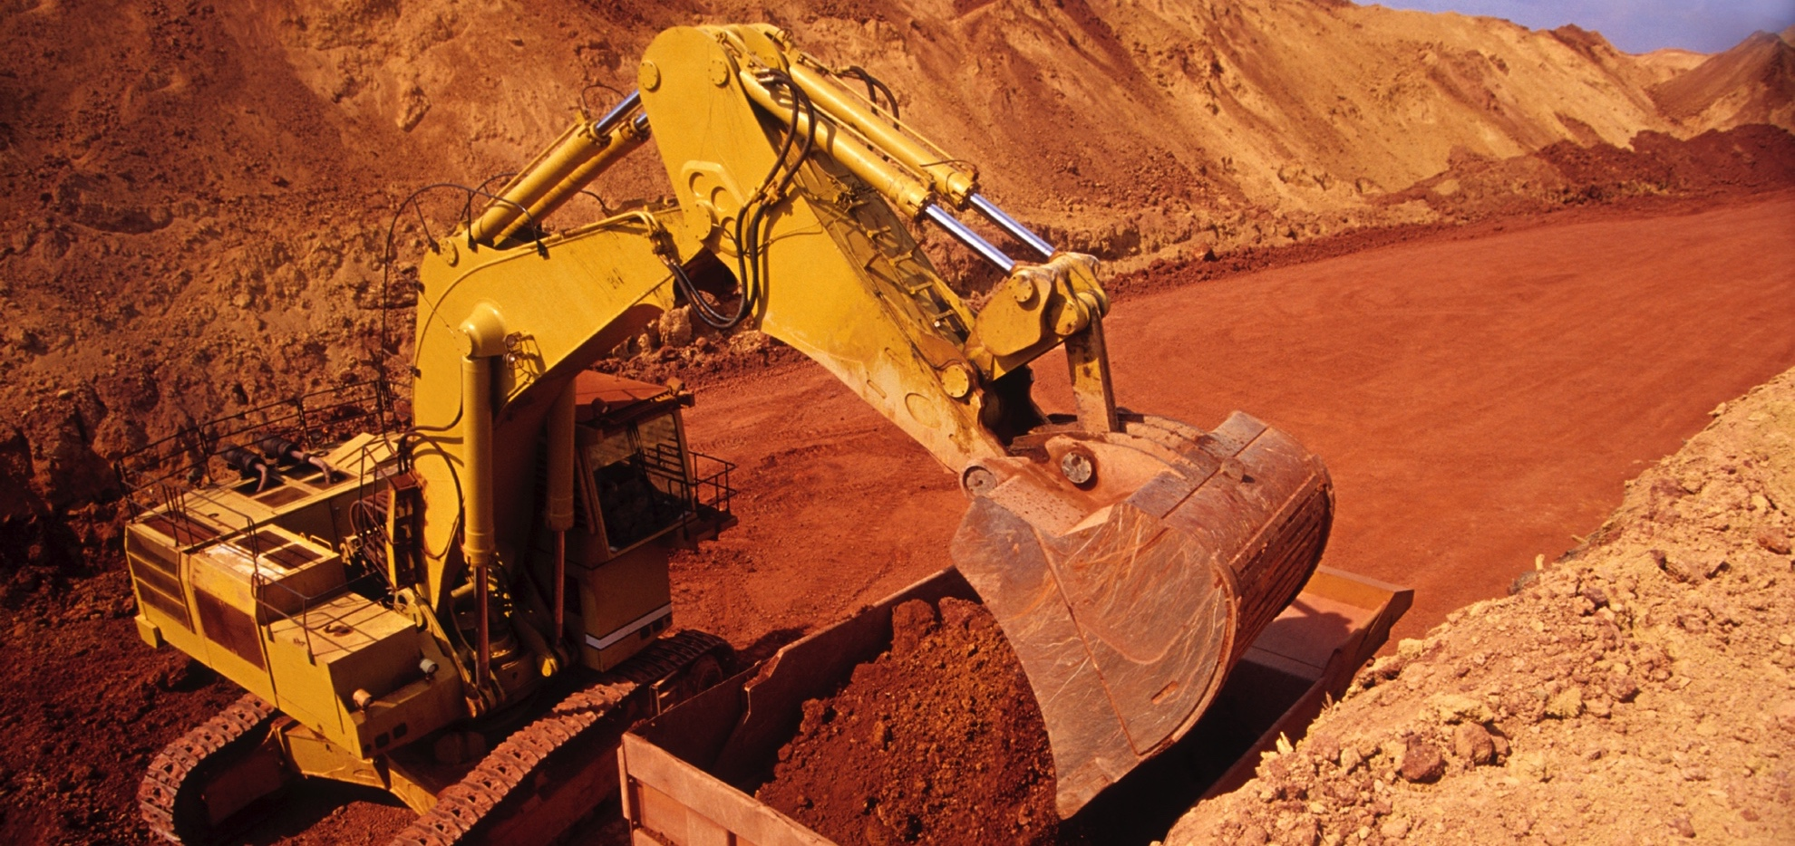
Step 1: Bauxite mining
Bauxite ore (which contains aluminum) is mined from the ground in places like Brazil, Jamaica, China, and India.
Bauxite mining uses less than 1 unit
of the energy needed to make one can.
Explain

Slide 13

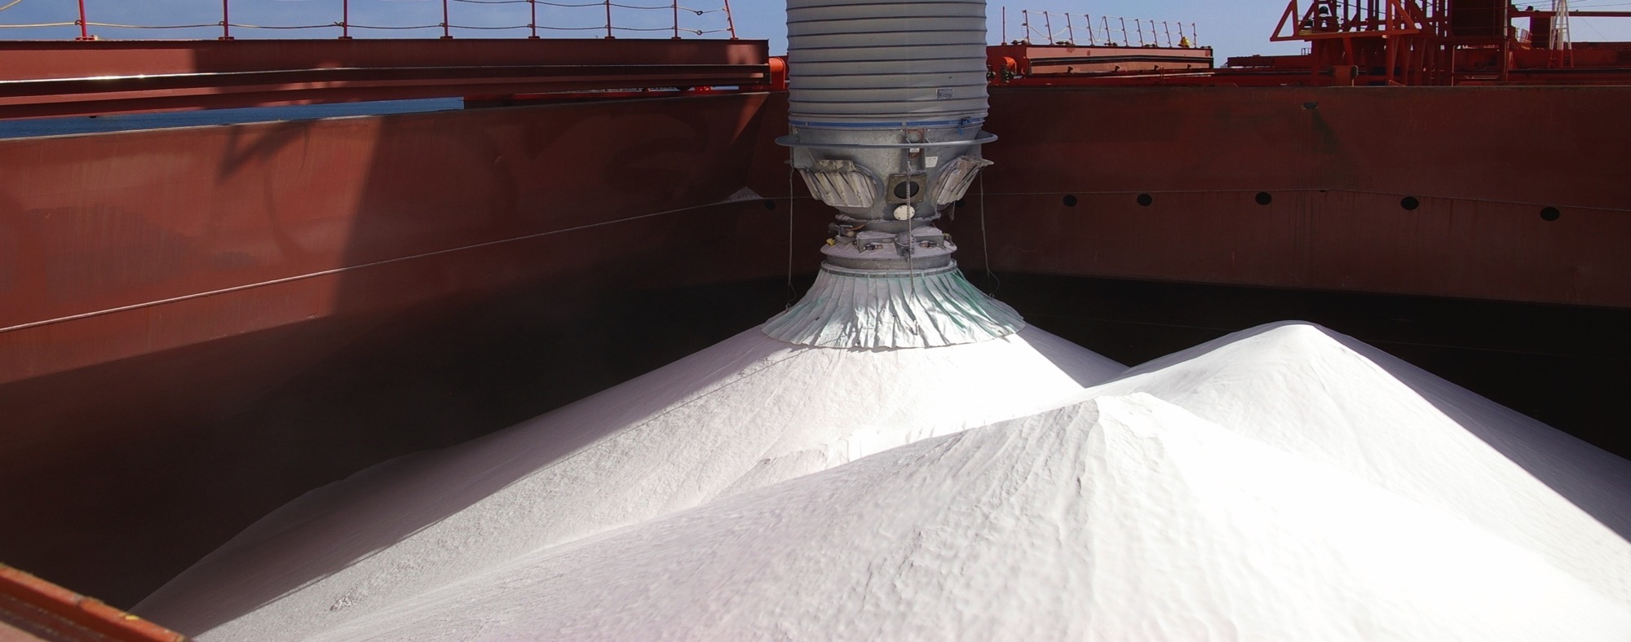
Step 2: Alumina refining
The refining process removes impurities from the bauxite. This leaves behind a fine white powder made of aluminum and oxygen. The powder is called alumina.
Alumina refining uses about 15 units of the energy needed to make one can.
Explain

Slide 14

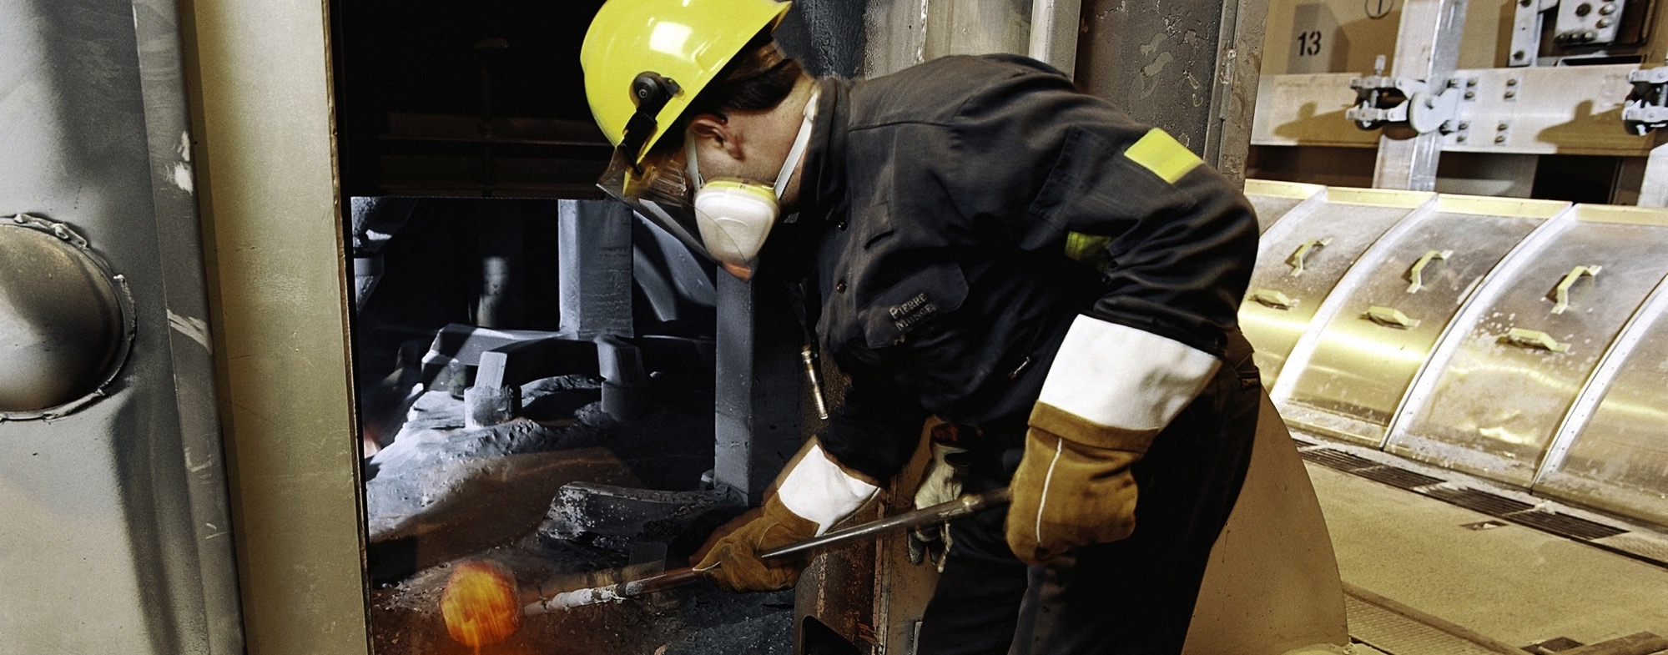
Step 3: Aluminum smelting
An electric current zaps the alumina, which separates the aluminum from the oxygen. The aluminum melts into a bubbly liquid that looks like silver lava.
Alumina smelting uses 70 units of the energy needed to make one can.
Explain

Slide 15

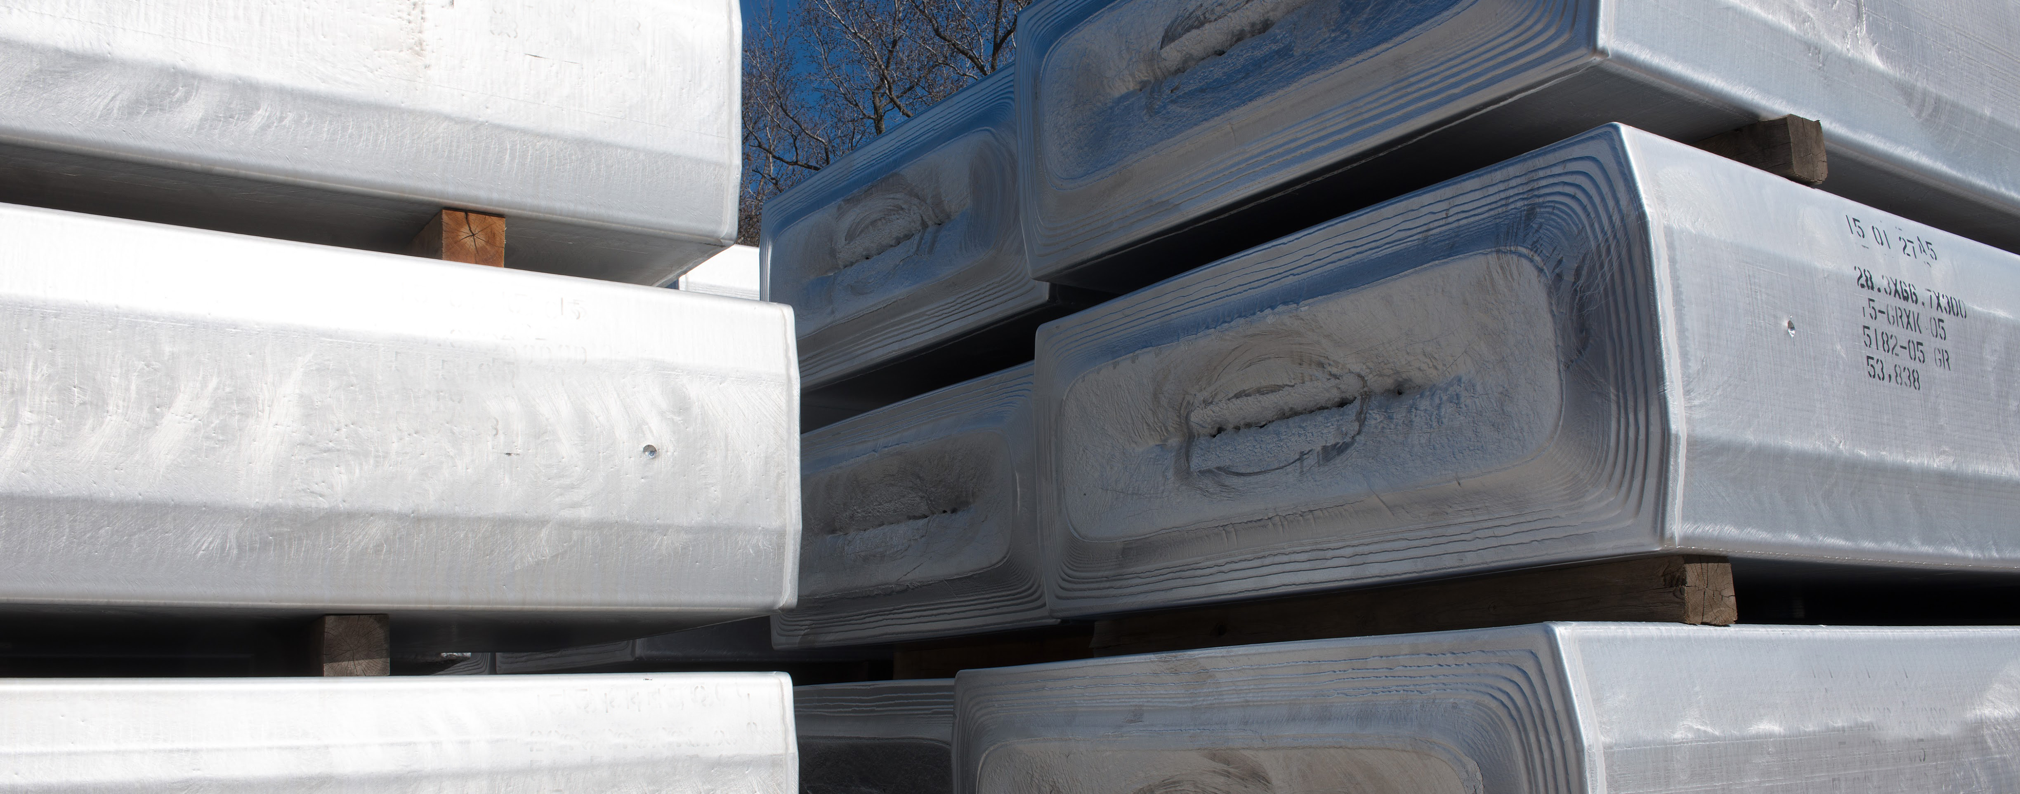
Step 4: Ingot casting
The molten aluminum flows into molds and is sprayed with water to cool it down. As it cools, it hardens into a solid. This solid block is called a ingot.
Ingot casting uses less than 1 unit of the energy needed to make one can.
Explain

Slide 16
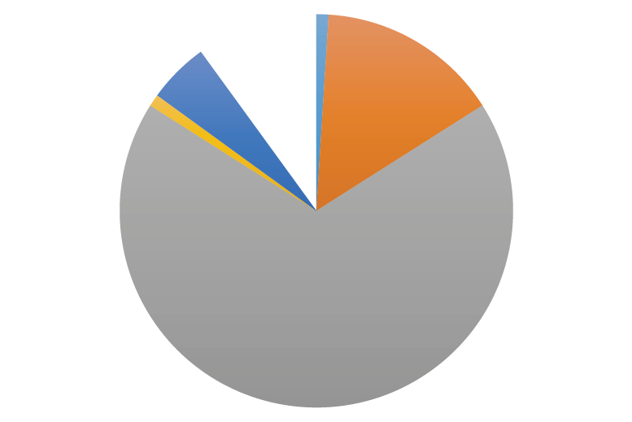
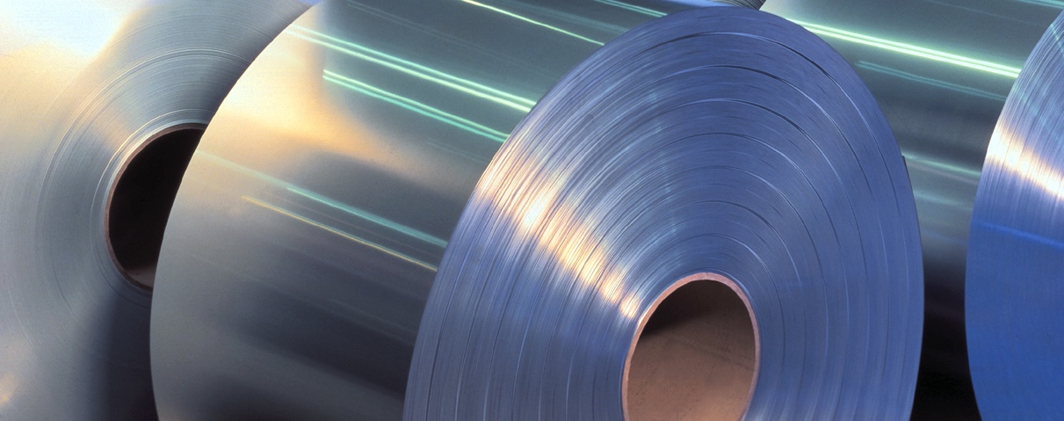
Step 5: Sheet production
Aluminum ingots are heated and passed through a series of rollers. A long, thin sheet is produced and coiled.
Sheet production uses 5 units of the energy needed to make one can.
Explain

Slide 17
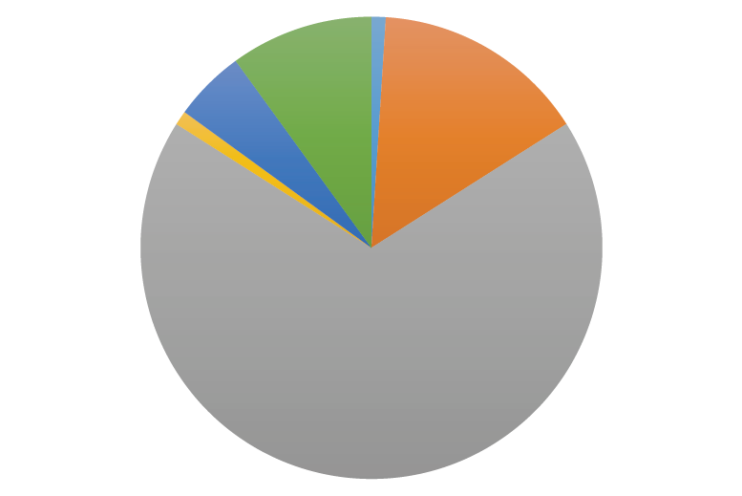
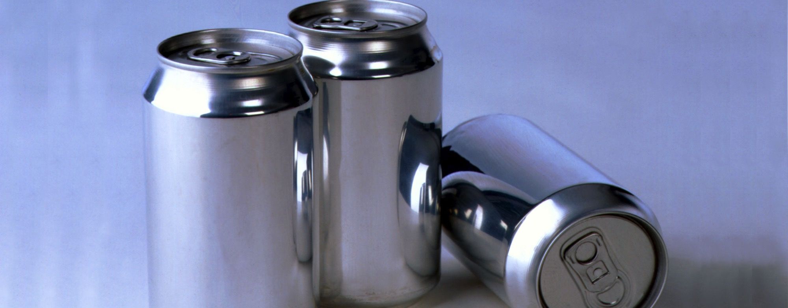
Step 6: Can-making
Cans are trimmed, printed, and cleaned. Then, they are filled with the beverage and sealed.
Can making uses 10 units of the energy needed to make one can.
Explain

Slide 18

Step 7: To the consumer!
Which part of the manufacturing process used the most energy?
What happens to the can once the consumer drinks the beverage?
Explain

Slide 19
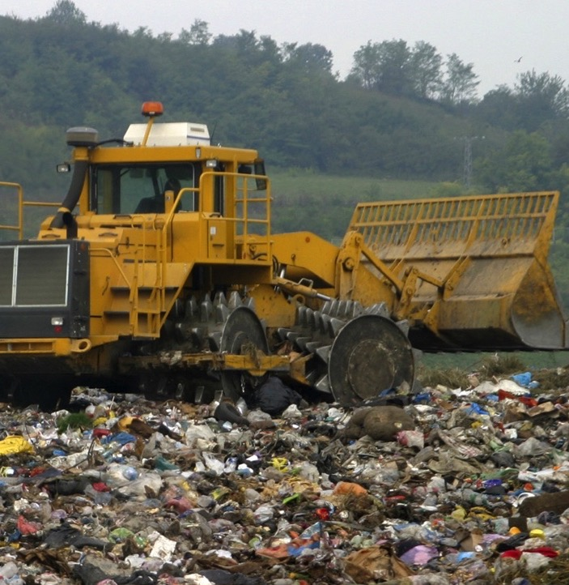
To the trash
A can that goes into the trash will disappear into a landfill. If you need a new can, you will have to start from the beginning, with bauxite mining.
How much energy is required to make a new can from new materials?
Explain

Slide 20
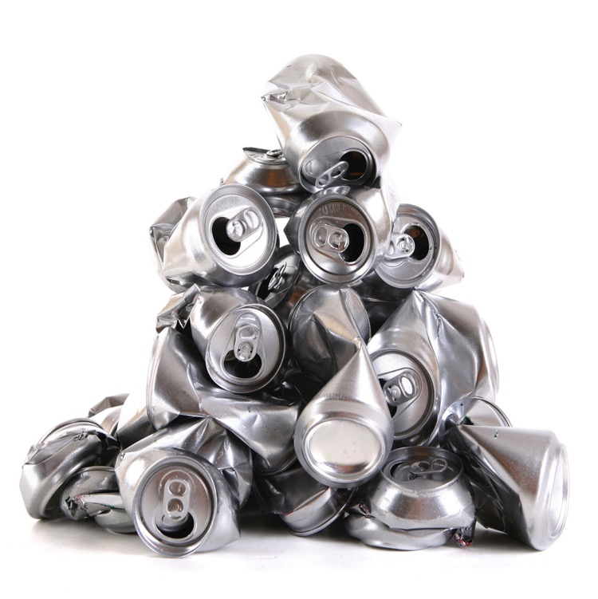

Step 8: RECYCLE!
How can we save energy by Recycling?
How do we recycle?
  Cans are collected, compressed, and sent to a recycling plant.
  At the plant, they are shredded and melted, and start the cycle at INGOT CASTING.
  What happens next?
Explain

Slide 21
Step 8: RECYCLE!
What CAN happen in 60 days?
  A used aluminum can is recycled, remade, refilled, and returned to the store shelf!
Explain
Notes:
DESIGN NOTES: Include Life-Cycle of the Aluminum Can graphic

Slide 22
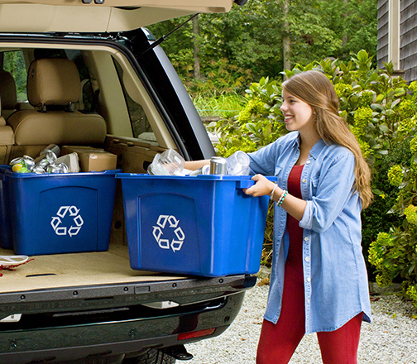
Recycle: Saving energy
Which steps of the manufacturing process did you skip because you recycled and started at ingot casting?
How much energy did you use to go through the rest of the process?
How much energy did you save by recycling your can?
Explain

Slide 23

I Can!
I, ___________________________________, pledge to help the environment by recycling at least once a day.
  When I recycle, I help reduce waste in landfills because….
  When I recycle, I help conserve natural resources because….
  When I recycle, I help reduce energy use because….
In taking this action, I am doing my part to have a positive impact on the environment and the world.
__________________________________ _________________
Signature Date
Evaluate

